Slide 1
Java training #2 – Collections and comparable
December 2019
Notes:
SF reports folder:
https://algosec.lightning.force.com/lightning/r/Folder/00l0z0000026QAoAAM/view?queryScope=userFolders

Slide 2
Collections
A collection (container) – a single unit that groups multiple elements
The motivation is to have a single united framework for all types of collections
The framework includes:
Interfaces of collections (List, Set)
Implementations of collections – ArrayList, HashSet
Iterators
Algorithms
Streams (lambda)
Why use it?
Speed up implementation
Reuse code
Single API
Efficient and well tested algorithms
Notes:
RBC, ZKB, Schulmberger, Telstra, Nets

Slide 3
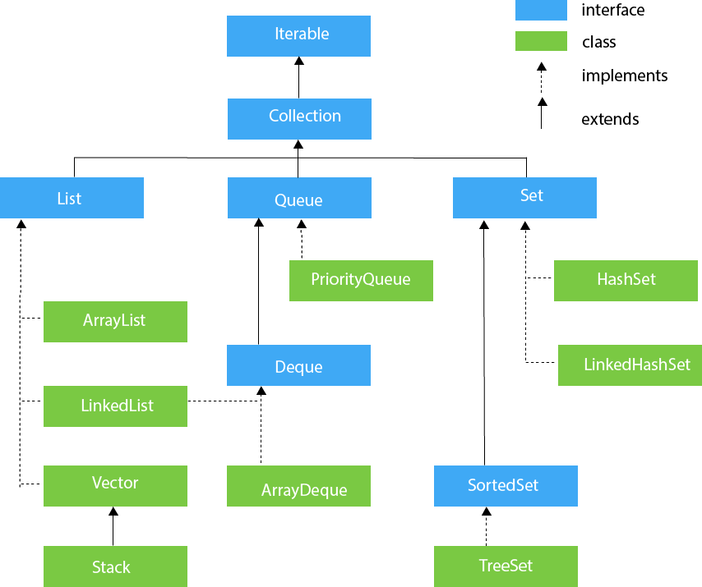
Collections
Notes:
RBC, ZKB, Schulmberger, Telstra, Nets

Slide 4
List example
See class UseCollections in code
Why are we using Integer and not int?
Notes:
RBC, ZKB, Schulmberger, Telstra, Nets

Slide 5
Comparable
A collection has algorithms – one of them is sort
You can use it as follows:
List<Student> myList = new ArrayList<>();
myList.add(new Student(“Amichai”);
myList.add(new Student(“Michal”);
myList.sort();
The sort method calls the compareTo() of the classes it sorts – using a given algorithm.
Notes:
RBC, ZKB, Schulmberger, Telstra, Nets

Slide 6
Comparator
What if I want to sort in more than a single way a given collection?
Use comparator!
How can I chain comparators? What will it do?
How can I chain in a different way?
Notes:
RBC, ZKB, Schulmberger, Telstra, Nets

